Slide 1
Data Structures and Algorithms (CCE 221)
By
Dr : Asmaa Aly Hagar

Slide 2
Course Academic Calendar
Week Num | Date | Content
Week1 | 24/9/2025 | Introduction to Data Structures + Mathematics Review + Review of Concepts of ‘C++’
Week2 | 01/10/2025 | Sparse Matrix, Concepts of Class, and Analysis of Algorithms
Week3 | 08/10/2025 | Linked Lists
Week4 | 15/10/2025 | Stack
Week5 | 22/10/2025 | Queue
Week6 | 15/10/2025 | Trees
Week7 | 29/10/2025 | Midterm
Week8 | 05/11/2025 | AVL Trees
Week9 | 12/11/2025 | Priority Queues and Heaps
Week10 | 19/11/2025 | Graph
Week11 | 26/11/2025 | Searching and Sorting
Week12 | 03/12/2025 | Hashing

Slide 3
Lecture3

Slide 4
Contents of the Lecture
Lists
What is a Linked List?
Linked Lists ADT
Advantages and Disadvantages of Linked Lists
Comparison of Linked Lists with Arrays
Singly Linked Lists
Doubly Linked Lists
Circular Linked Lists
A Memory-efficient Doubly Linked List
Unrolled Linked Lists
Skip Lists

Slide 5



What is the List?
A list is a sequential set of data items (values).
A collection of elements stored in contiguous memory locations. It allows random access by index.
In a general list:
New values are added in position determined by the user.
Element is removed from a position determined by the user.

Slide 6
How Lists Work?
Insertion position
0
n
MAX-1
Insertion range
Should be shifted one cell right
Insert New Element
??
New element
0
n+1
MAX-1
Shifted elements
We can insert a new element in position 0≤p≤n+1, where n is the number of elements within the list.

Slide 7
How Lists Work?
Deletion position
0
n
MAX-1
Deletion range
Should be shifted one cell left
Delete an Element
??
0
n
MAX-1
Shifted elements
We can delete an element from position 0≤p≤n,where n is the number of elements within the list.
.

Slide 8
Lists
Many applications require resizing, and the required size not always immediately available.
For those applications, the linked list is preferred.

Slide 9

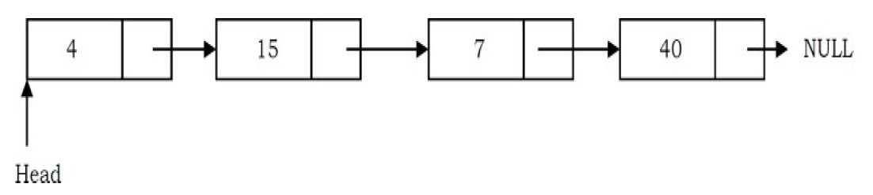
Linked Lists
Linked list is a linear data structure consisting of a sequence of nodes connected to each other.
Each node stores:
Data
Link to the next node
A linked list is a data structure used for storing collections of data.
A linked list has the following properties.
Successive elements are connected by pointers
The last element points to NULL
Can grow or shrink in size during execution of a program
Can be made just as long as required (until systems memory exhausts)
Does not waste memory space (but takes some extra memory for pointers). It allocates memory as list grows.

Slide 10
Linked Lists
NULL

Slide 11
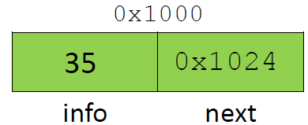
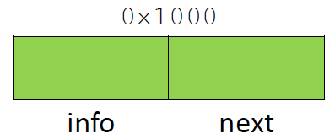
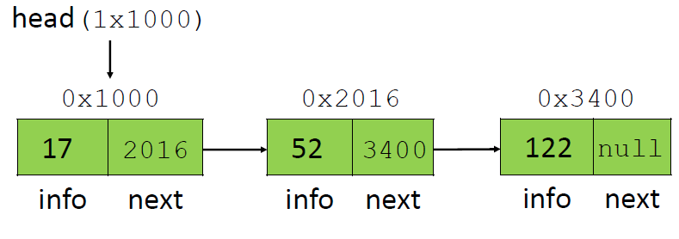
Pointer to first node
Pointer to next node
Data member
NULL pointer (points to nothing)

Slide 12

Linked Lists ADT
The following operations make linked lists an ADT:
Main Linked Lists Operations
Insert: inserts an element into the list
Delete: removes and returns the specified position element from the list
Auxiliary Linked Lists Operations
Delete List: removes all elements of the list (disposes the list)
Count: returns the number of elements in the list
Find $n^{th}$ node from the end of the list

Slide 13
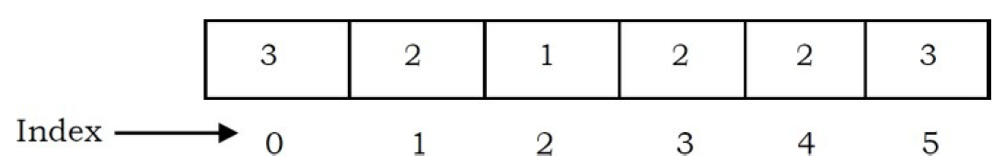
Array
Arrays Overview
One memory block is allocated for the entire array to hold the elements of the array.
The array elements can be accessed in constant time by using the index of the particular element as the subscript.
Why Constant Time for Accessing Array Elements?
To access an array element, the address of an element is computed as an offset from the base address of the array and one multiplication is needed to compute what is supposed to be added to the base address to get the memory address of the element.
First the size of an element of that data type is calculated and then it is multiplied with the index of the element to get the value to be added to the base address.
This process takes one multiplication and one addition. Since these two operations take constant time, we can say the array access can be performed in constant time.

Slide 14
Array
Advantages of Arrays
Simple and easy to use
Faster access to the elements (constant access)
Disadvantages of Arrays
Preallocates all needed memory up front and wastes memory space for indices in the array that are empty.
Fixed size: The size of the array is static (specify the array size before using it).
One block allocation: To allocate the array itself at the beginning, sometimes it may not be possible to get the memory for the complete array (if the array size is big).
Complex position-based insertion: To insert an element at a given position, we may need to shift the existing elements. This will create a position for us to insert the new element at the desired position. If the position at which we want to add an element is at the beginning, then the shifting operation is more expensive.

Slide 15
Dynamic Array
Dynamic Arrays
Dynamic array (also called as growable array, resizable array, dynamic table, or array list) is a random access, variable-size list data structure that allows elements to be added or removed.
One simple way of implementing dynamic arrays is to initially start with some fixed size array. As soon as that array becomes full, create the new array double the size of the original array. Similarly, reduce the array size to half if the elements in the array are less than half.

Slide 16
Advantages and Disadvantages of Linked Lists
Advantages:
Are dynamic data structure: i.e., they can grow or shrink during the execution of the program.
Efficient memory utilization: In linked list (or dynamic) representation, memory is not pre-allocated. Memory is allocated whenever it is required. And it is deallocated (or removed) when it is not needed.
Insertion and deletion are easier and efficient. Linked list provides flexibility in inserting a data item at a specified position and deletion of a data item from the given position.
Many complex applications can be easily carried out with linked list.
Disadvantages:
More memory: to store an integer number, a node with integer data and address field is allocated. That is more memory space is needed.
Access to an arbitrary data item is little bit cumbersome and also time consuming.

Slide 17
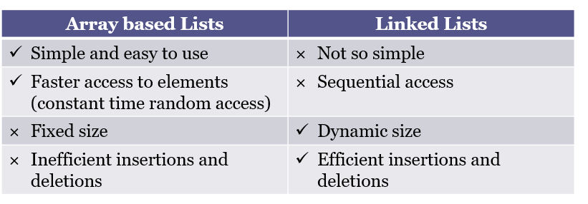
Array based Lists vs Linked Lists

Slide 18
Representation of Linked List
Suppose we want to store a list of integer numbers using linked list. Then it can be schematically represented as:
The linear linked list can be represented in memory with the following declaration.

Slide 19
Operations on Linked List
The primitive operations performed on the linked list are as follows
Creation
Insertion
Deletion
Traversing
Searching
Concatenation
Creation operation is used to create a linked list . Once a linked list is created with one node, insertion operation can be used to add more elements in a node.
Insertion operation is used to insert a new node at any specified location in the linked list. A new node may be inserted:
At the beginning of the linked list
At the end of the linked list
At any specified position in between in a linked list

Slide 20
Operations on Linked List
Deletion operation is used to delete an item (or node ) from the linked list. A node may be deleted from the:
Beginning of a linked list
End of a linked list
Specified location of the linked list
Traversing is the process of going through all the nodes from one end to another end of a linked list. In a singly linked list we can visit from left to right , forward traversing, nodes only. But in doubly linked list forward and backward traversing is possible
Concatenation is the process of appending the second list to the end of the first list Consider a list A having n nodes and B with m nodes. Then the operation concatenation will place the 1 st node of B in the (n+1) th node in A. After concatenation A will contain ( n+m ) nodes

Slide 21
Types of Linked Lists
The link list are of three types such as
Singly Link List
Doubly Link List
Circular Link List

Slide 22
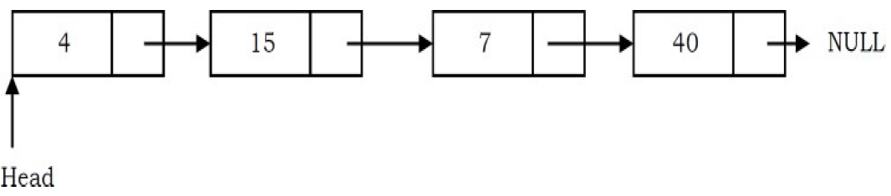
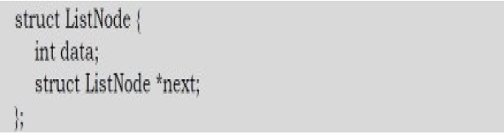
Singly Linked Lists
Generally, “linked list” means a singly linked list. This list consists of a number of nodes in which each node has a next pointer to the following element. The link of the last node in the list is NULL, which indicates the end of the list.
Following is a type declaration for a linked list of integers:

Slide 23
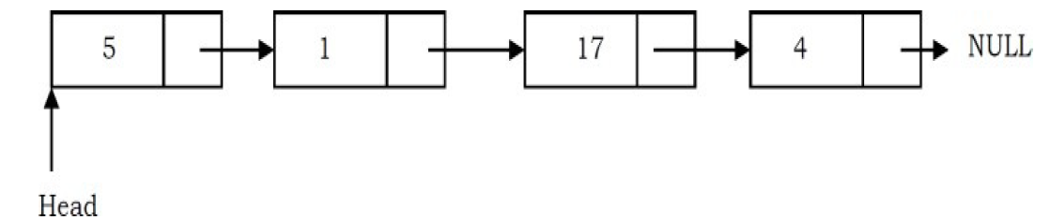
Singly Linked Lists
Basic Operations on a List
Traversing the list
Inserting an item in the list
Deleting an item from the list
Traversing the Linked List
Let us assume that the head points to the first node of the list. To traverse the list, we do the Following
Follow the pointers.
Display the contents of the nodes (or count) as they are traversed.
Stop when the next pointer points to NULL.
Time Complexity: O(n), for scanning the list of size n.

Slide 24
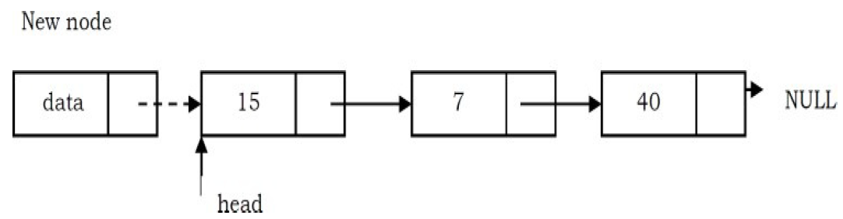
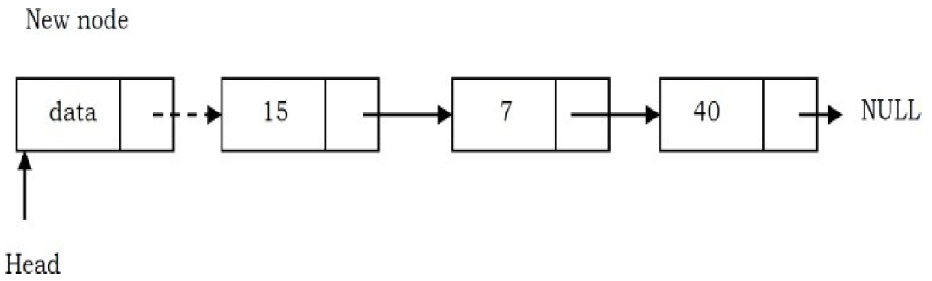
Singly Linked Lists
Singly Linked List Insertion
Insertion into a singly-linked list has three cases:
Inserting a new node before the head (at the beginning)
Inserting a new node after the tail (at the end of the list)
Inserting a new node at the middle of the list (random location)
Inserting a Node in Singly Linked List at the Beginning
In this case, a new node is inserted before the current head node. Only one next pointer needs to
be modified (new node’s next pointer) and it can be done in two steps:
Update the next pointer of new node, to point to the current head.
Update head pointer to point to the new node.

Slide 25
Singly Linked Lists
Inserting a Node in Singly Linked List at the Ending
In this case, we need to modify two next pointers (last nodes next pointer and new nodes next
pointer).
New nodes next pointer points to NULL.
Last nodes next pointer points to the new node.
Inserting a Node in Singly Linked List at the Middle
Let us assume that we are given a position where we want to insert the new node. In this case also, we need to modify two next pointers.
If we want to add an element at position 3 then we stop at position 2. That means we traverse 2 nodes and insert the new node. For simplicity let us assume that the second node is called position node. The new node points to the next node of the position where we want to add this node.

Slide 26
Singly Linked Lists
Position node’s next pointer now points to the new node.
Time Complexity: O(n), since, in the worst case, we may need to insert the node at the end of the
list.
Singly Linked List Deletion
Similar to insertion, here we also have three cases.
Deleting the first node
Deleting the last node
Deleting an intermediate node

Slide 27
Singly Linked Lists
Deleting the First Node in Singly Linked List
First node (current head node) is removed from the list. It can be done in two steps:
Create a temporary node which will point to the same node as that of head.
Now, move the head nodes pointer to the next node and dispose of the temporary node.
Deleting the Last Node in Singly Linked List
In this case, the last node is removed from the list. This operation is a bit trickier than removing the first node, because the algorithm should find a node, which is previous to the tail. It can be done in three steps:
Traverse the list and while traversing maintain the previous node address also. By the time we reach the end of the list, we will have two pointers, one pointing to the tail node and the other pointing to the node before the tail node.
Update previous node’s next pointer with NULL.

Slide 28
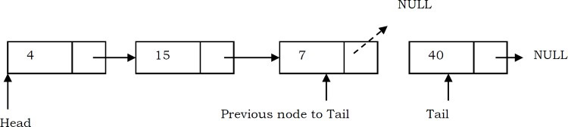
Singly Linked Lists
Dispose of the tail node.
Deleting an Intermediate Node in Singly Linked List
In this case, the node to be removed is always located between two nodes. Head and tail links
are not updated in this case. Such a removal can be done in two steps:
Similar to the previous case, maintain the previous node while traversing the list. Once we find the node to be deleted, change the previous node’s next pointer to the next pointer of the node to be deleted.
Dispose of the current node to be deleted
Time Complexity: O(n). In the worst case, we may need to delete the node at the end of the list.

Slide 29
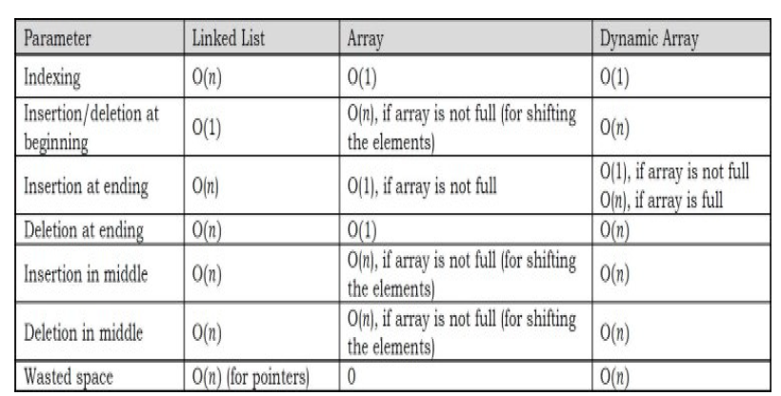
Comparison of Linked Lists with Arrays & Dynamic Arrays

Slide 30
Doubly Linked Lists
A doubly linked list is one in which all nodes are linked together by multiple links which help in accessing both the successor (next ) and predecessor (previous ) node for any arbitrary node within the list.
Every nodes in the doubly linked list has three fields:
Left Pointer
Right Pointer
DATA

Slide 31
Doubly Linked Lists
LPoint will point to the node in the left side (or previous node) that is LPoint will hold the address of the previous node.
RPoint will point to the node in the right side (or next node) that is RPoint will hold the address of the next node.
DATA will store the information of the node

Slide 32
Doubly Linked List Representation
A node in the doubly linked list can be represented in memory with the following declarations.
All the operations performed on singly linked list can also be performed on doubly linked
list.

Slide 33
Doubly Linked List Insertion
Insertion into a doubly-linked list has three cases (same as singly linked list):
Inserting a new node before the head.
Inserting a new node after the tail (at the end of the list).
Inserting a new node at the middle of the list.
Inserting a Node in Doubly Linked List at the Beginning
In this case, new node is inserted before the head node. Previous and next pointers need to be modified and it can be done in two steps:
Update the right pointer of the new node to point to the current head node (dotted link in below figure) and also make left pointer of new node as NULL.
Update head node’s left pointer to point to the new node and make new node as Head.

Slide 34
Doubly Linked List Insertion
Inserting a Node in Doubly Linked List at the Ending
In this case, traverse the list till the end and insert the new node.
New node right pointer points to NULL and left pointer points to the end of the list.
Update right pointer of last node to point to new node.
Inserting a Node in Doubly Linked List at the Middle
As discussed in singly linked lists, traverse the list to the position node and insert the new node.
New node right pointer points to the next node of the position node where we want to insert the new node. Also, new node left pointer points to the position node.
Position node right pointer points to the new node and the next node of position node left pointer points to new node.

Slide 35
Doubly Linked List Deletion
Similar to singly linked list deletion, here we have three cases:
Deleting the first node
Deleting the last node
Deleting an intermediate node
Deleting the First Node in Doubly Linked List
In this case, the first node (current head node) is removed from the list. It can be done in two
steps:
Create a temporary node which will point to the same node as that of head.
Now, move the head nodes pointer to the next node and change the heads left pointer to NULL. Then, dispose of the temporary node.

Slide 36
Doubly Linked List Deletion
Deleting the Last Node in Doubly Linked List
This operation is a bit trickier than removing the first node, because the algorithm should find a
node, which is previous to the tail first. This can be done in three steps:
Traverse the list and while traversing maintain the previous node address also. By the time we reach the end of the list, we will have two pointers, one pointing to the tail and the other pointing to the node before the tail.
Update the next pointer of previous node to the tail node with NULL.
Dispose the tail node.

Slide 37
Doubly Linked List Deletion
Deleting an Intermediate Node in Doubly Linked List
In this case, the node to be removed is always located between two nodes, and the head and tail links are not updated. The removal can be done in two steps:
Similar to the previous case, maintain the previous node while also traversing the list. Upon locating the node to be deleted, change the previous node’s next pointer to the next node of the node to be deleted.
Dispose of the current node to be deleted.

Slide 38
Circular Linked Lists
A circular linked list is one, which has no beginning and no end .
A singly linked list can be made a circular linked list by simply storing the address of the very first node in the linked field of the last node.
While traversing the circular linked lists we should be careful; otherwise, we will be traversing the list infinitely.
In circular linked lists, each node has a successor.
Note that unlike singly linked lists, there is no node with NULL pointer in a circularly linked list.

Slide 39
Circular Linked Lists
In some situations, circular linked lists are useful.
For example, when several processes are using the same computer resource (CPU) for the same amount of time, we have to assure that no process accesses the resource before all other processes do (round robin algorithm).
The following is a type declaration for a circular linked list of integers:
In a circular linked list, we access the elements using the head node (similar to head node in singly linked list and doubly linked lists).
Circular linked lists are used in managing the computing resources of a computer. We can use circular lists for implementing stacks and queues.

Slide 40
Counting Nodes in a Circular Linked List
The circular list is accessible through the node marked head.
To count the nodes, the list has to be traversed from the node marked head, with the help of a dummy node current, and stop the counting when current reaches the starting node head.
If the list is empty, head will be NULL, and in that case set count = 0.
Otherwise, set the current pointer to the first node, and keep on counting till the current pointer reaches the starting node.

Slide 41
Printing the Contents of a Circular Linked List
We assume here that the list is being accessed by its head node. Since all the nodes are arranged in a circular fashion, the tail node of the list will be the node previous to the head node.
Let us assume we want to print the contents of the nodes starting with the head node.
Print its contents, move to the next node and continue printing till we reach the head node again.

Slide 42
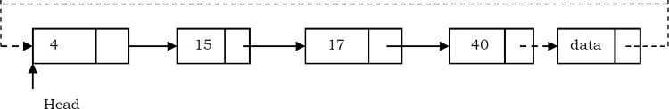
Inserting a Node at the End of a Circular Linked List
Let us add a node containing data, at the end of a list (circular list) headed by head. The new
node will be placed just after the tail node (which is the last node of the list), which means it will
have to be inserted in between the tail node and the first node.
Create a new node and initially keep its next pointer pointing to itself.
Update the next pointer of the new node with the head node and also traverse the list to the tail. That means in a circular list we should stop at the node whose next node is head.
Update the next pointer of the previous node to point to the new node.

Slide 43
Inserting a Node at the Front of a Circular Linked List
The only difference between inserting a node at the beginning and at the end is that, after inserting
the new node, we just need to update the pointer. The steps for doing this are given below:
Create a new node and initially keep its next pointer pointing to itself.
Update the next pointer of the new node with the head node and also traverse the list until the tail. That means in a circular list we should stop at the node which is its previous node in the list.
Update the previous head node in the list to point to the new node.
Make the new node as the head.

Slide 44
Deleting the Last Node in a Circular Linked List
The list has to be traversed to reach the last but one node. This has to be named as the tail node,
and its next field has to point to the first node. Consider the following list.
To delete the last node 40, the list has to be traversed till you reach 7. The next field of 7 has to
be changed to point to 60, and this node must be renamed pTail.
Traverse the list and find the tail node and its previous node.
Update the next pointer of tail node’s previous node to point to head.
Dispose of the tail node.

Slide 45
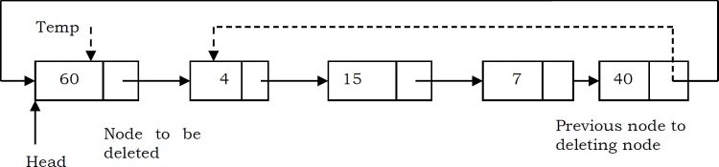
Deleting the First Node in a Circular List
The first node can be deleted by simply replacing the next field of the tail node with the next field
of the first node.
Find the tail node of the linked list by traversing the list. Tail node is the previous node to the head node which we want to delete.
Create a temporary node which will point to the head. Also, update the tail nodes next pointer to point to next node of head.
Now, move the head pointer to next node. Then, dispose of the temporary node.

Slide 46
Circular doubly Linked Lists
A circular doubly linked list has both the successor pointer and predecessor pointer in circular manner as shown below.

Slide 47
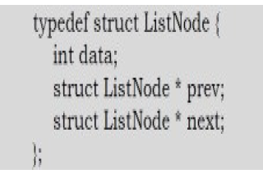
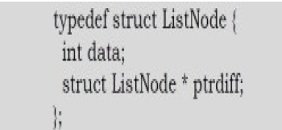
A Memory-efficient Doubly Linked List
Conventional Node Definition:
Recently a journal (Sinha) presented an alternative implementation of the doubly linked list ADT, with insertion, traversal and deletion operations.
This implementation is based on pointer difference. Each node uses only one pointer field to traverse the list back and forth.
New Node Definition:

Slide 48
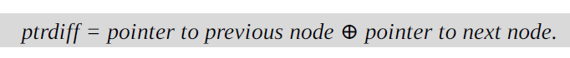
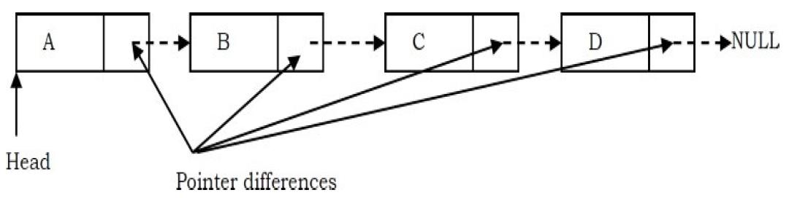
A Memory-efficient Doubly Linked List
The ptrdiff pointer field contains the difference between the pointer to the next node and the pointer to the previous node.
The pointer difference is calculated by using exclusive-or (⊕) operation.
Example:
The next pointer of A is: NULL ⊕ B
The next pointer of B is: A ⊕ C
The next pointer of C is: B ⊕ D
The next pointer of D is: C ⊕ NULL

Slide 49
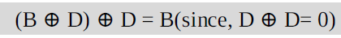
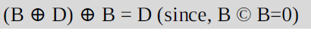
A Memory-efficient Doubly Linked List
Why does it work?
To find the answer to this question let us consider the properties of ⊕:
X ⊕ X=0
X ⊕ 0 = X
X ⊕ Y = Y ⊕ X (symmetric)
(X ⊕ Y) ⊕ Z = X ⊕ (Y ⊕ Z) (transitive)
For the example above, let us assume that we are at C node and want to move to B. We know that C’s ptrdiff is defined as B ⊕ D.
If we want to move to B, performing ⊕ on C’s ptrdiff with D would give B. This is due to the fact that
Similarly, if we want to move to D, then we have to apply ⊕ to C’s ptrdiff with B to give D.

Slide 50
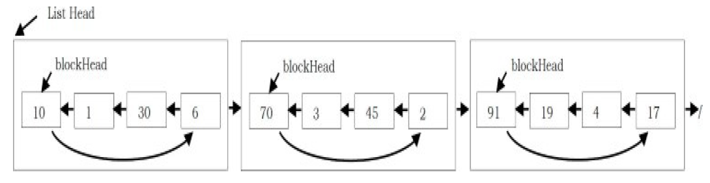
Unrolled Linked Lists
Like array and linked list, the unrolled Linked List is also a linear data structure and is a variant of the singly linked list.
An unrolled linked list stores multiple elements in each node (let us call it a block for our convenience).
In each block, a circular linked list is used to connect all nodes.

Slide 52
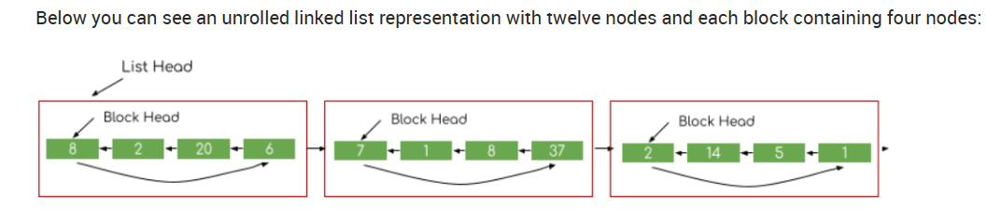
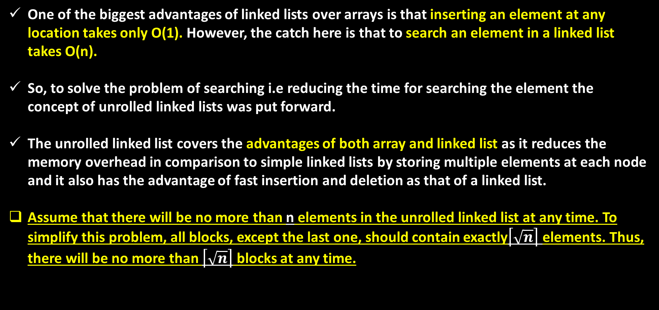
Why do we need unrolled linked list?
One of the biggest advantages of linked lists over arrays is that inserting an element at any location takes only O(1). However, the catch here is that to search an element in a linked list takes O(n).
So, to solve the problem of searching i.e reducing the time for searching the element the concept of unrolled linked lists was put forward.
The unrolled linked list covers the advantages of both array and linked list as it reduces the memory overhead in comparison to simple linked lists by storing multiple elements at each node and it also has the advantage of fast insertion and deletion as that of a linked list.
Assume that there will be no more than n elements in the unrolled linked list at any time. To simplify this problem, all blocks, except the last one, should contain exactly$\left\lceil \sqrt{n}\right\rceil$ elements. Thus, there will be no more than $\left\lceil \sqrt{n}\right\rceil$ blocks at any time.
Notes:
Floor: ⌊2.8⌋ = 2
Ceil: ⌈2.8⌉ = 3

Slide 53
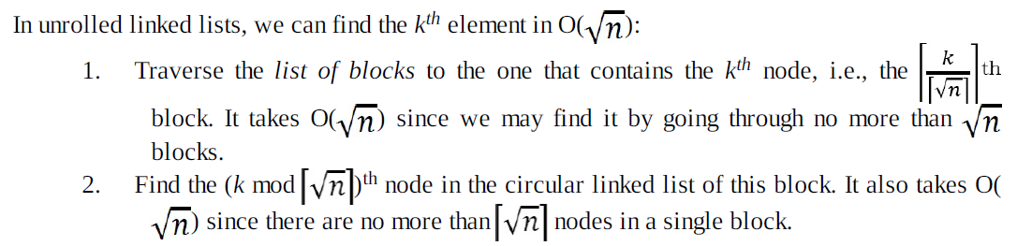
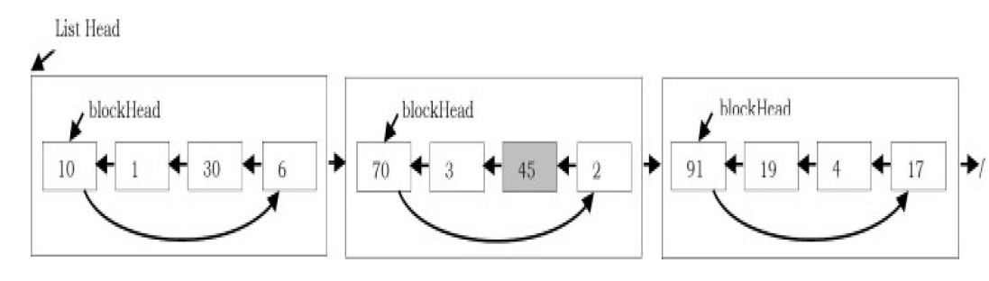
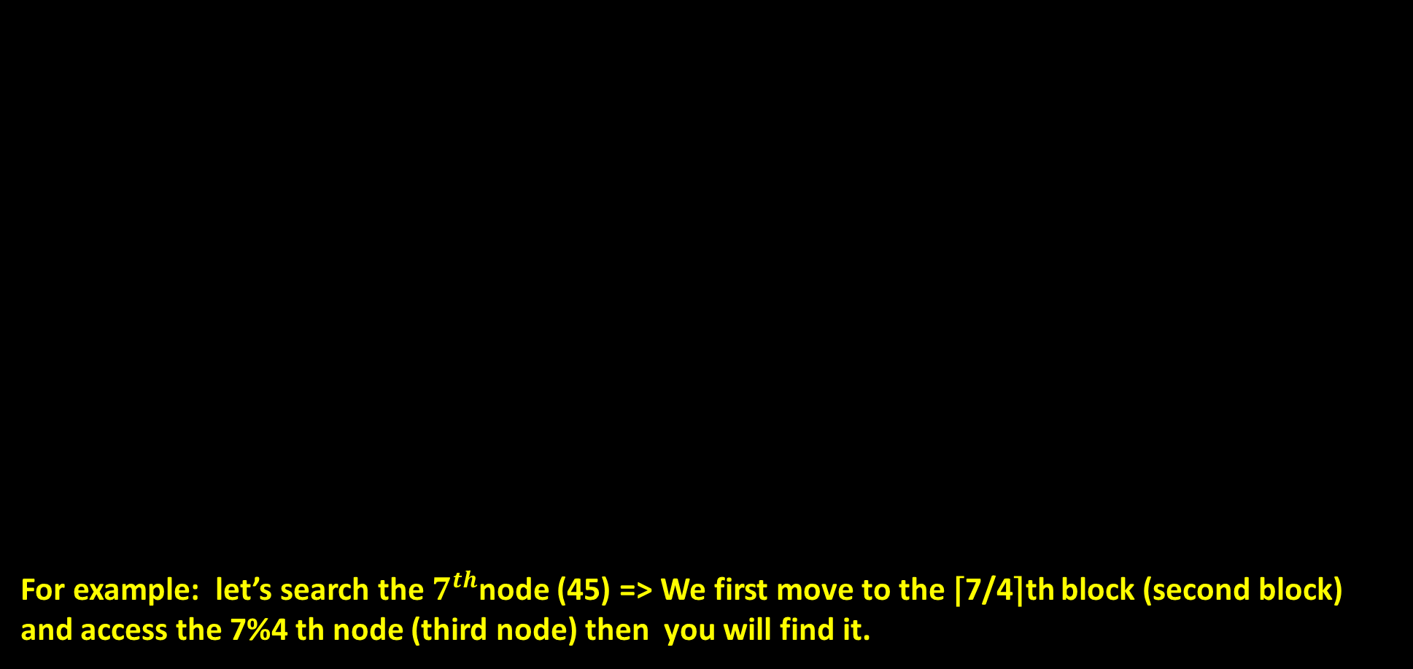
Searching for an element in Unrolled Linked Lists
For example: let’s search the $7^{th}$node (45) => We first move to the ⌈7/4⌉th block (second block) and access the 7%4 th node (third node) then you will find it.

Slide 54
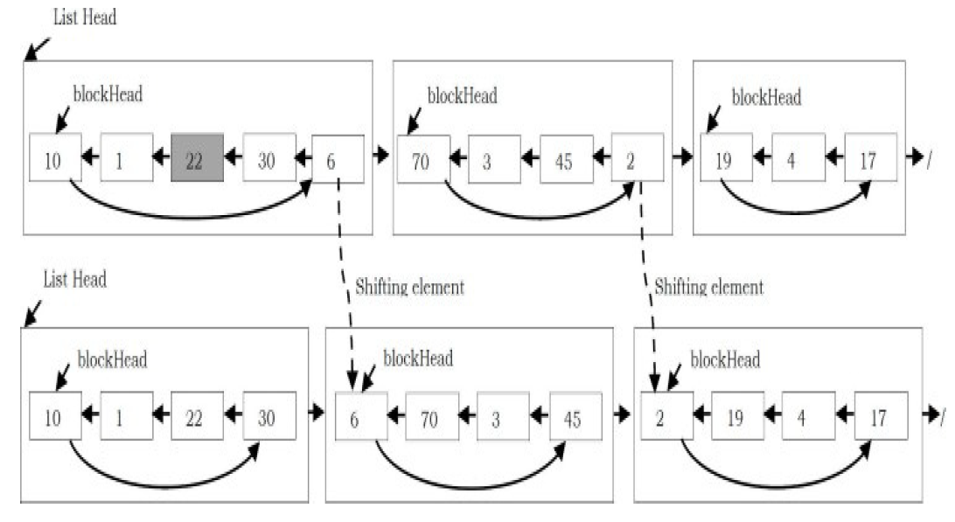
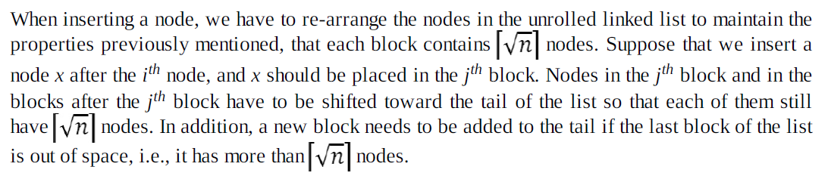
Inserting an element in Unrolled Linked Lists

Slide 55
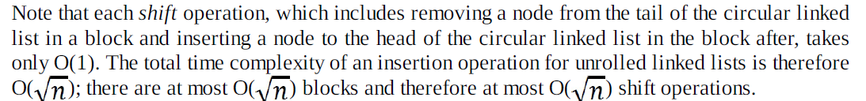
Performing Shift Operation

Slide 56
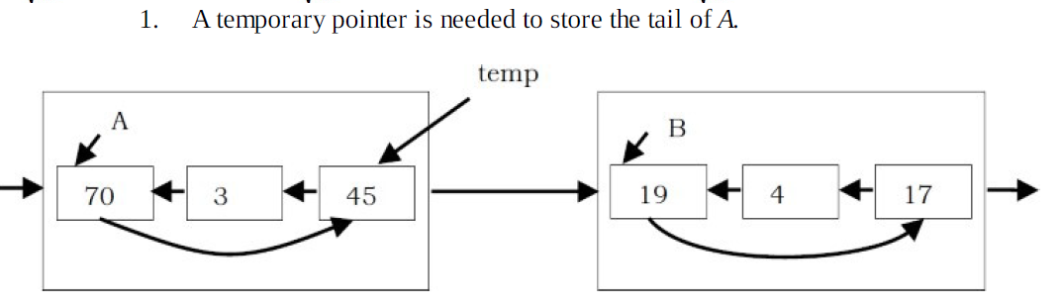
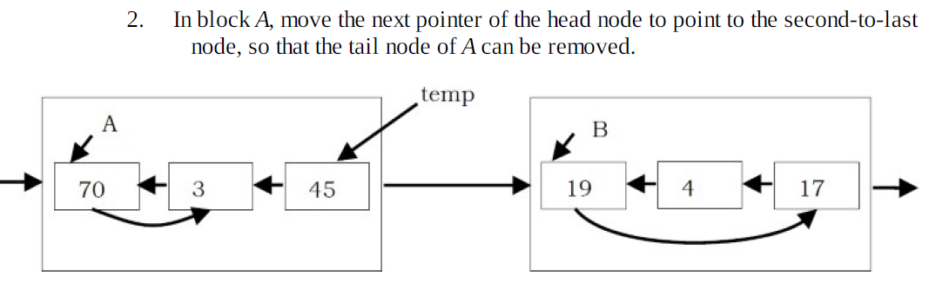
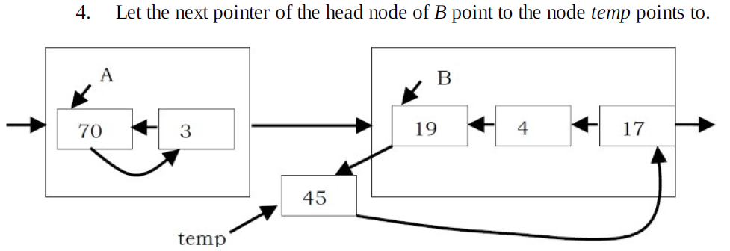
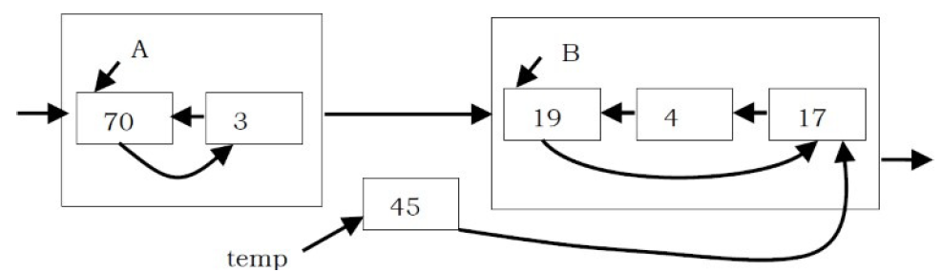
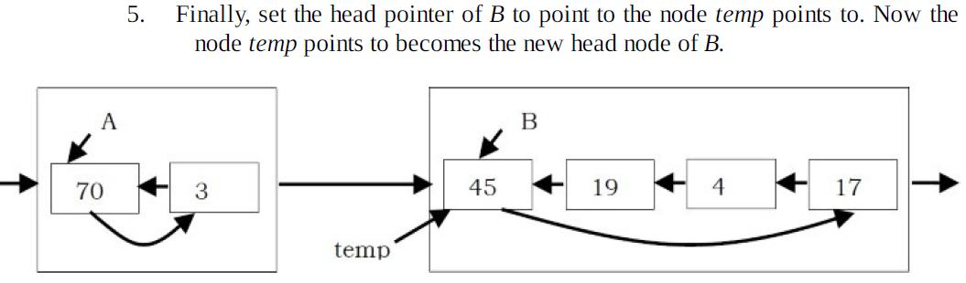
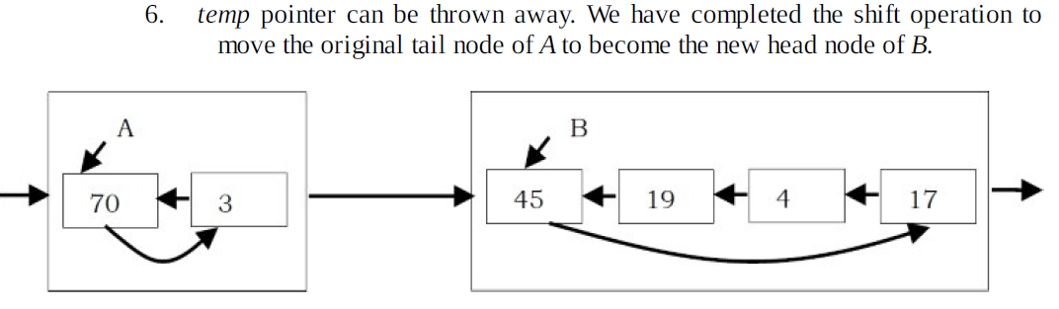

Slide 57
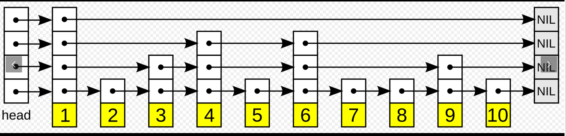
Skip Lists
A skip list is a data structure that allows for efficient search, insertion and deletion of elements in a sorted list.
It is a probabilistic data structure, meaning that its average time complexity is determined through a probabilistic analysis.
In a skip list, elements are organized in layers, with each layer having a smaller number of elements than the one below it. The bottom layer is a regular linked list, while the layers above it contain "skipping" links that allow for fast navigation to elements that are far apart in the bottom layer.

Slide 58
Skip Lists
The idea behind this is to allow for quick traversal to the desired element, reducing the average number of steps needed to reach it.
Skip lists are implemented using a technique called "coin flipping." In this technique, a random number is generated for each insertion to determine the number of layers the new element will occupy. This means that, on average, each element will be in log(n) layers, where n is the number of elements in the bottom layer.
Skip lists have an average time complexity of O(log n) for search, insertion and deletion.
https://medium.com/@asishpanda444/skip-lists-9e4cd1ee6444

Slide 59


